Slide 1
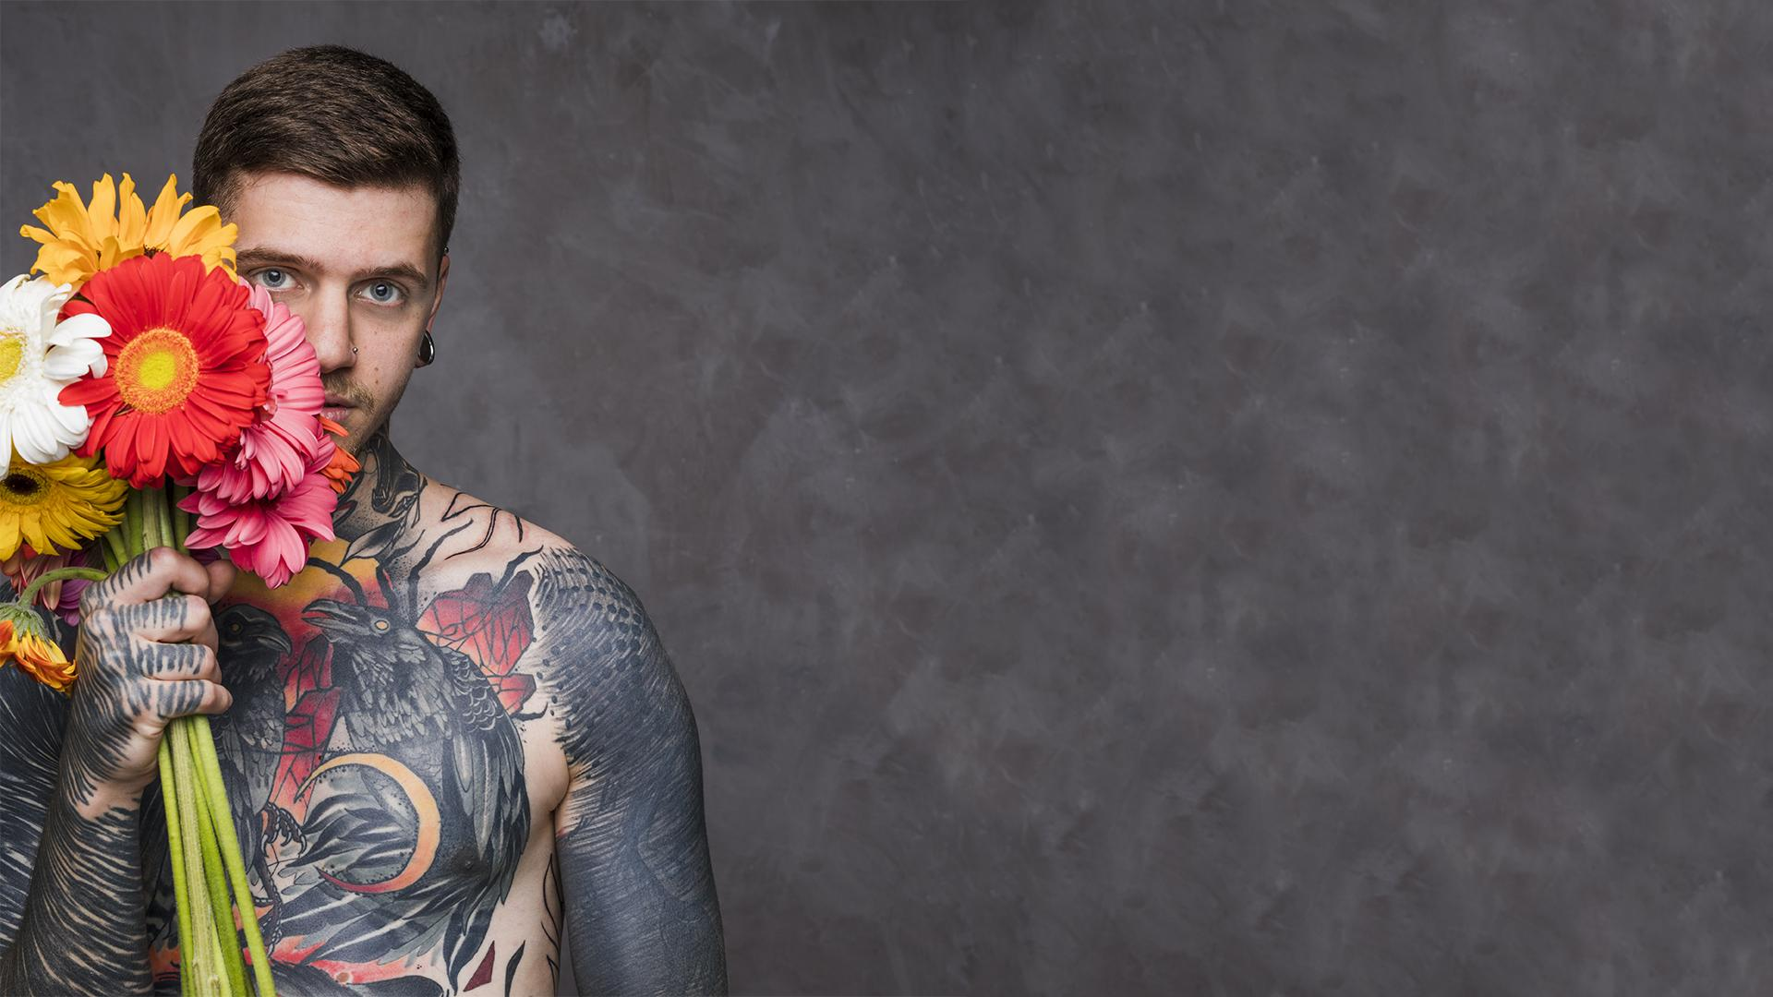
TATTOO STUDIO
Here is where our
presentation begins

Slide 2
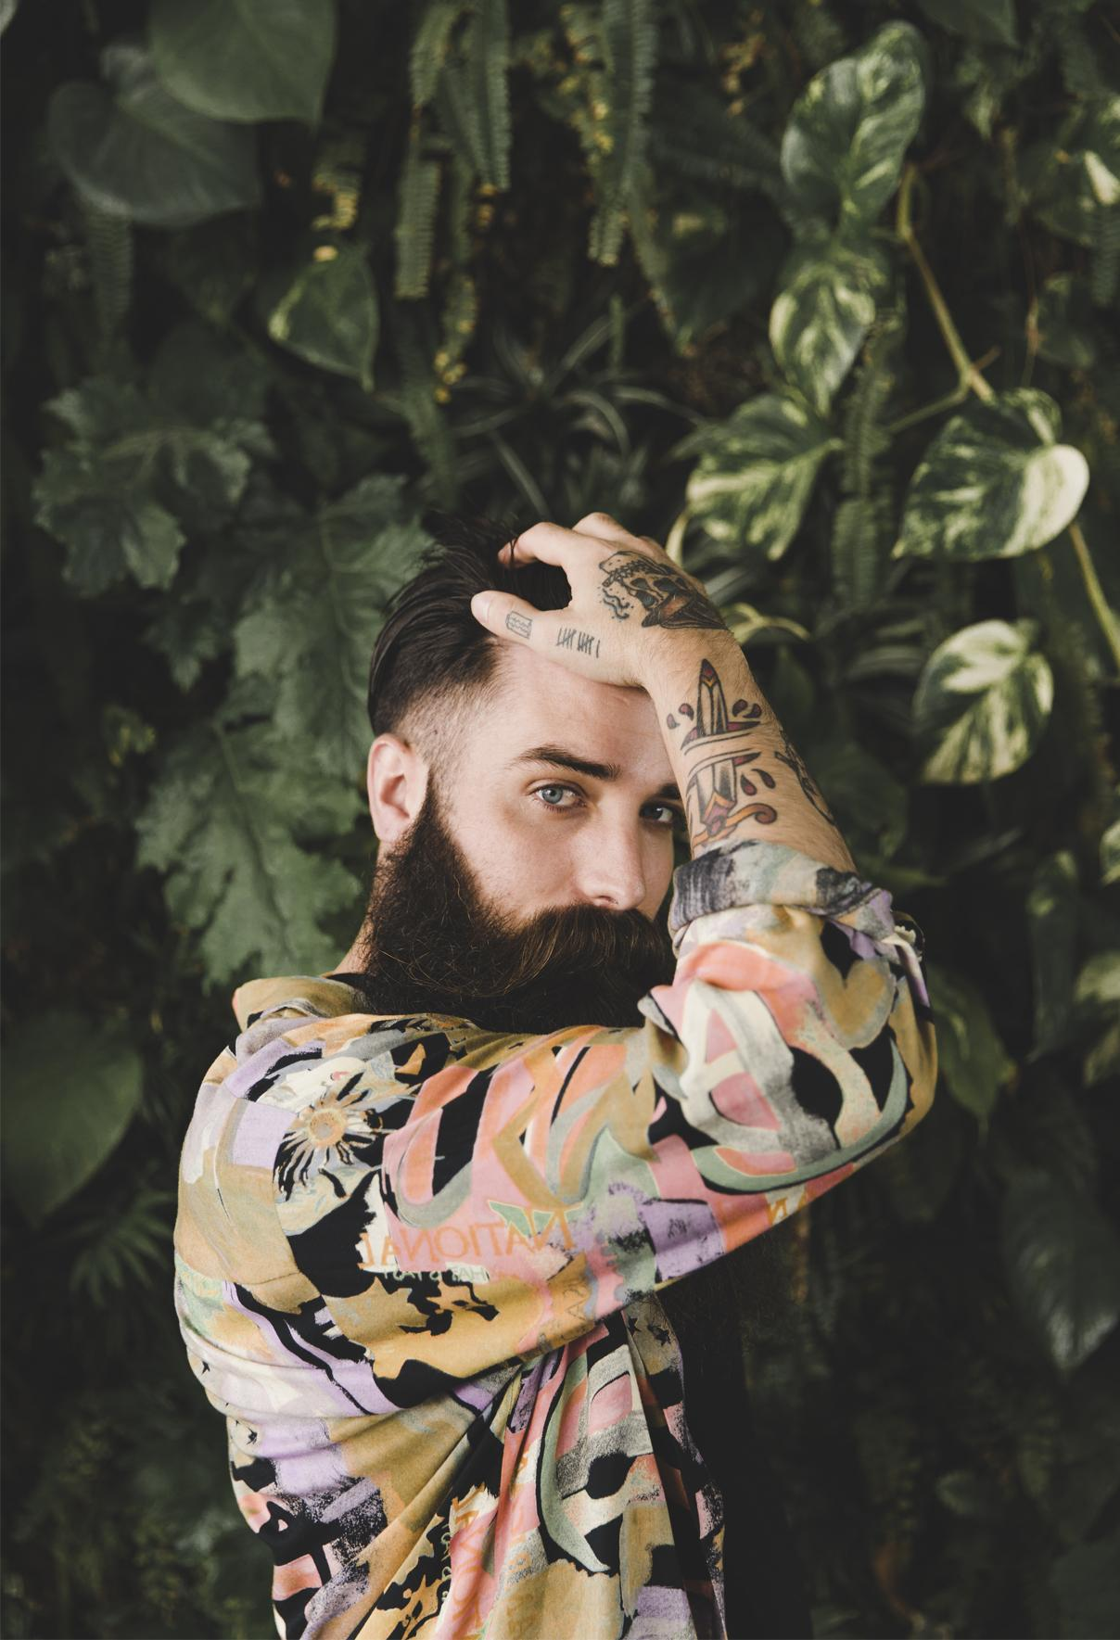
Table of Contents
Nosso time
01
Nossos serviços
02
Como fazemos?
03
Nossa Criação!
04
Group Apresatation
You Dream We Create.
You could describe the topic of the section here
We gona see our site!

Slide 3
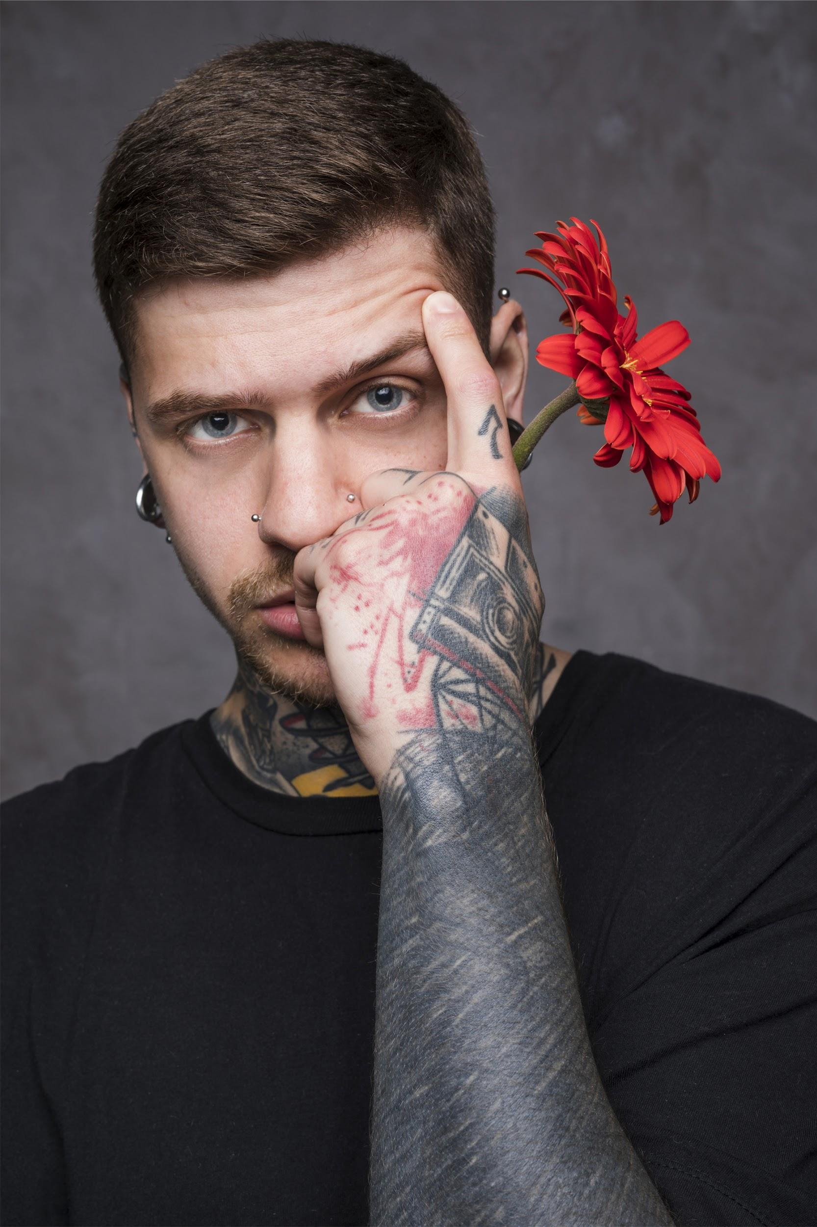
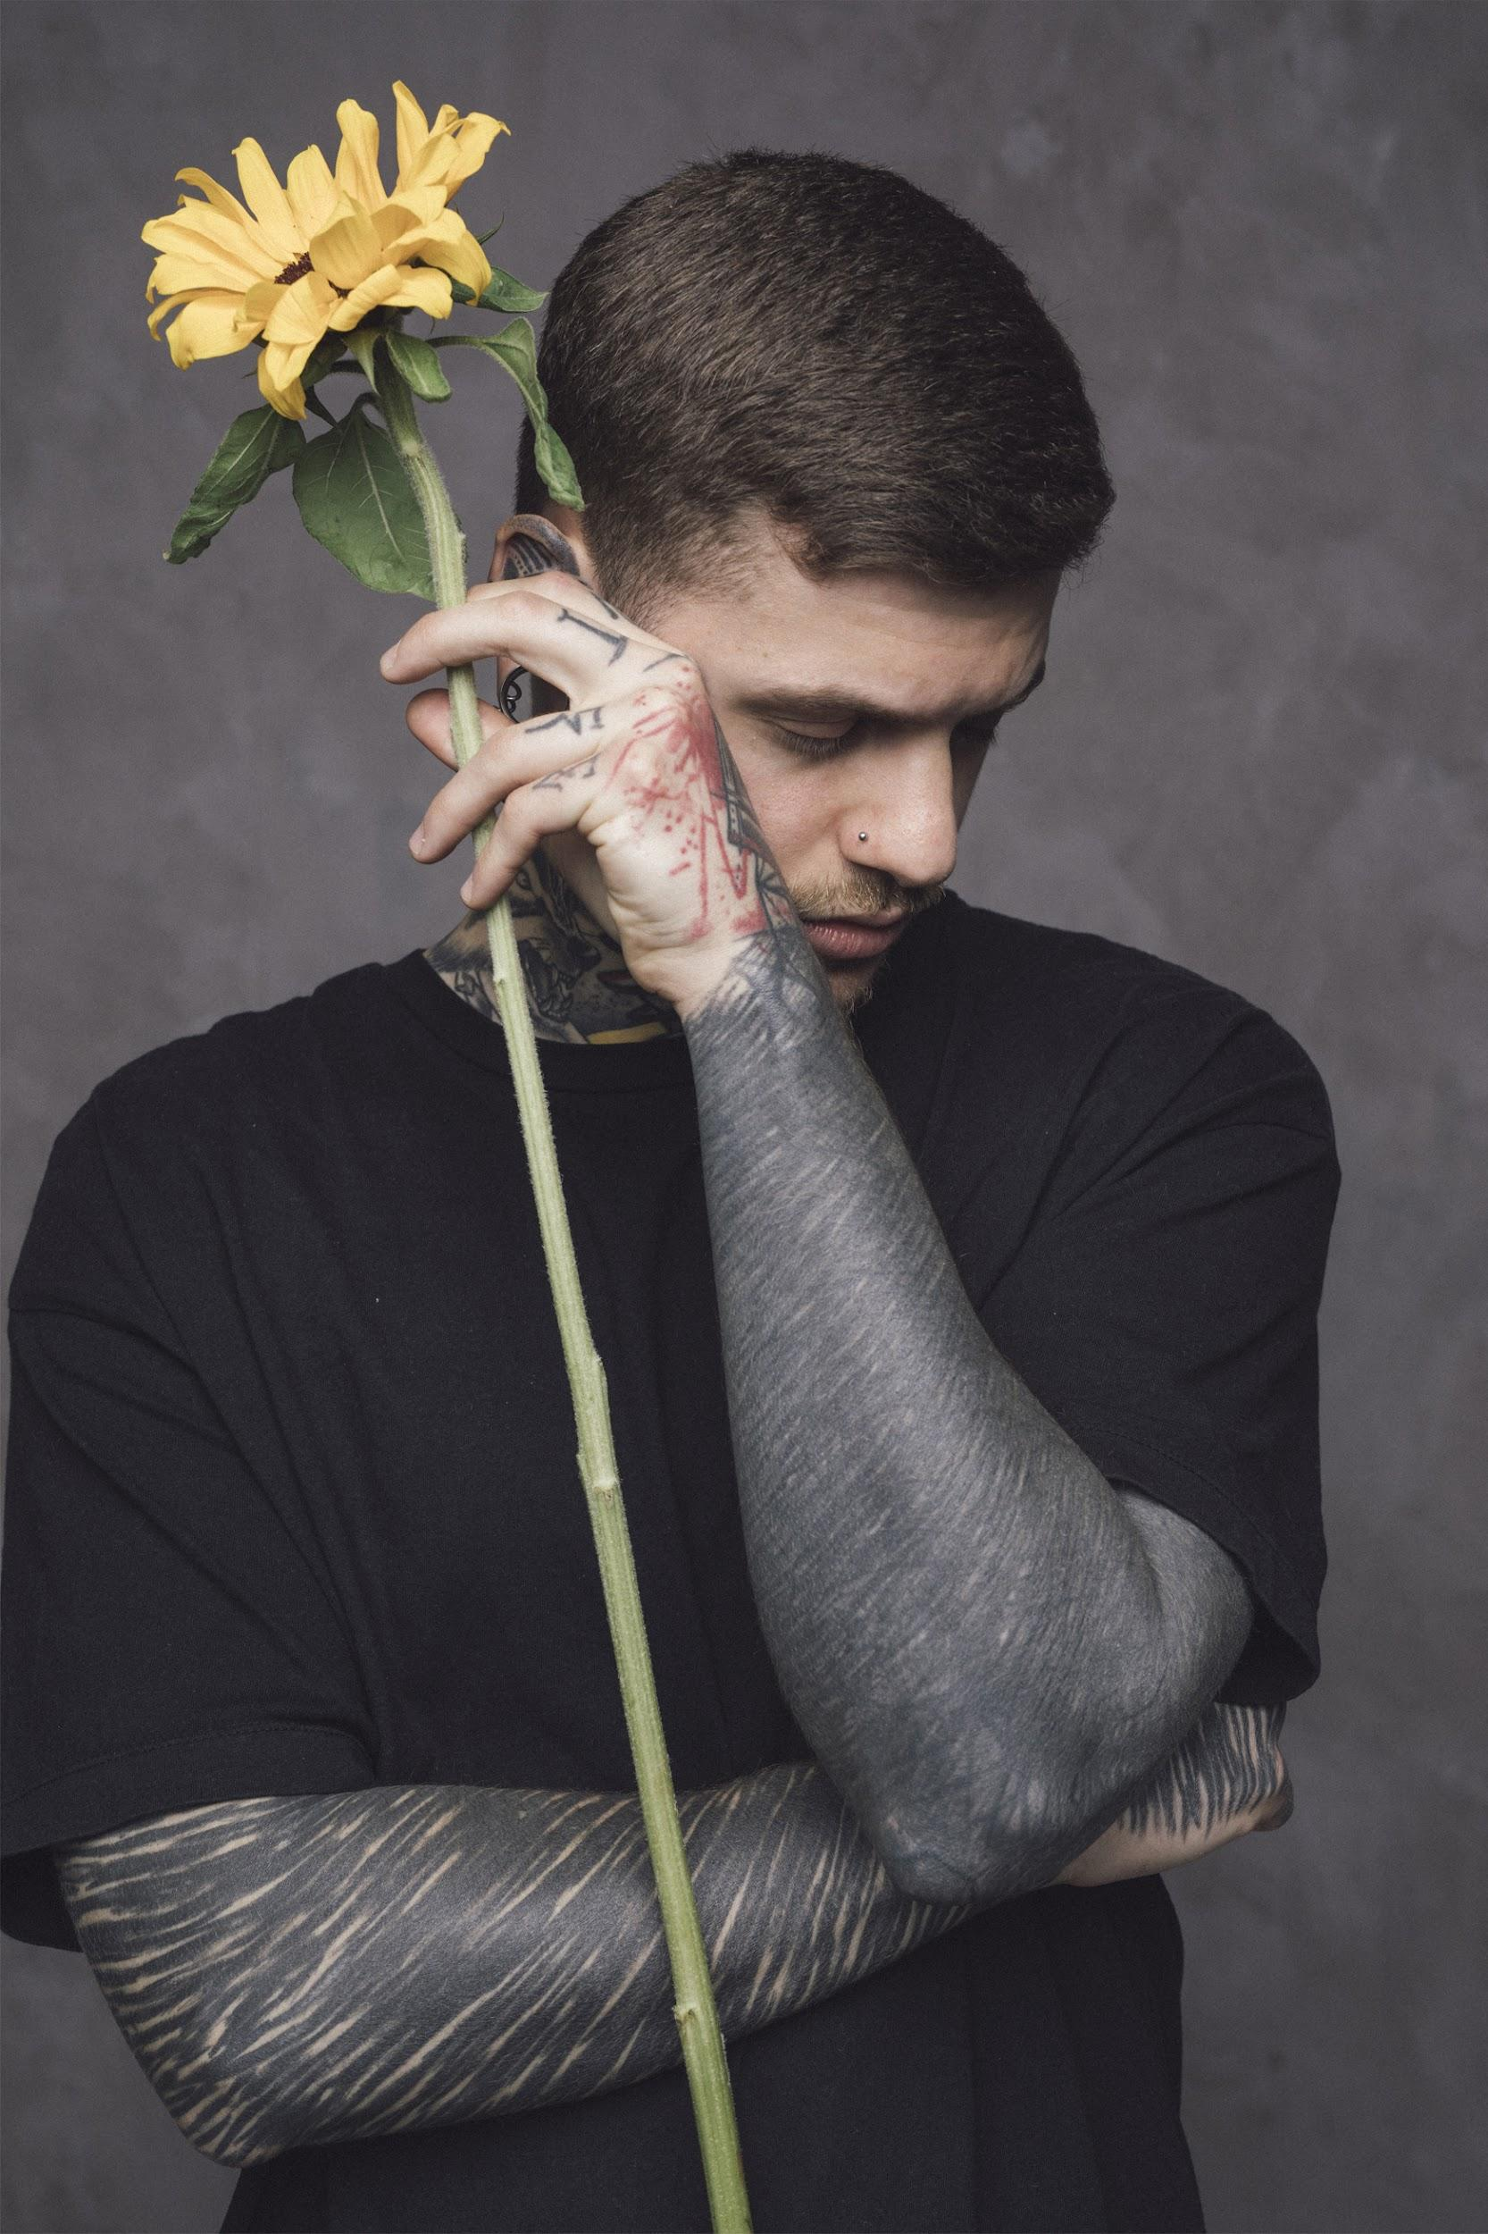
01
Our Team
Making your smile.

Slide 4
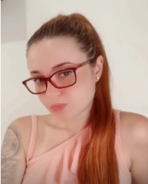
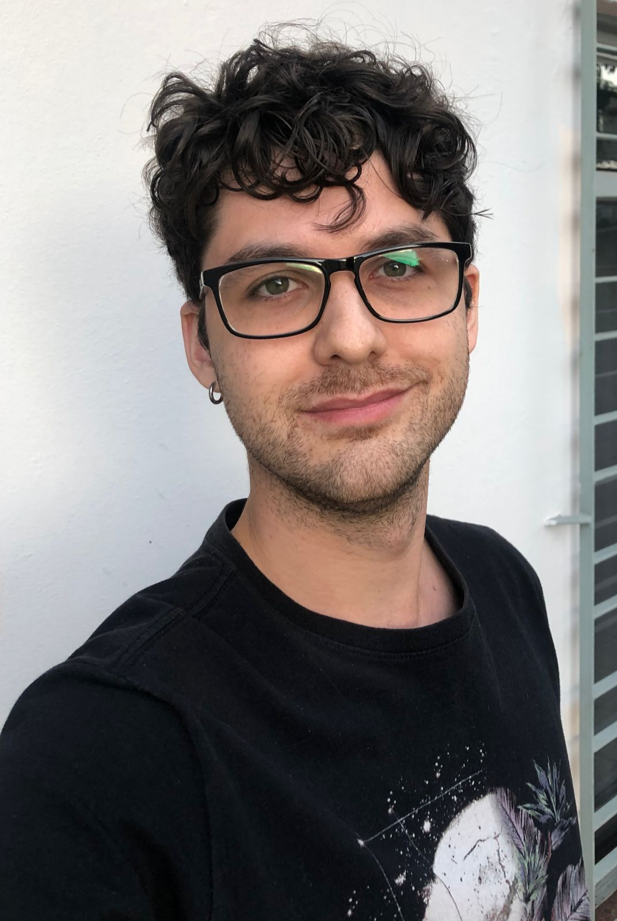
Our Team
Yasmin Ramos
Bruno Blanquez
Meus hobbys são estudar React e fan NBA.
Meus hobbys são tirar foto de perfil e deixar a barba no grau.

Slide 5
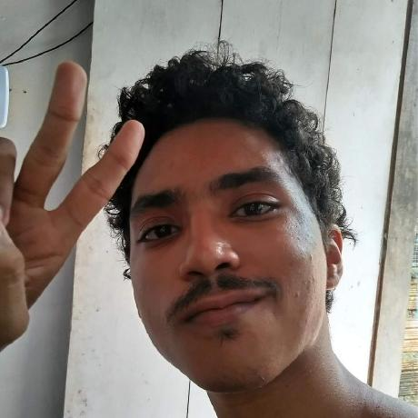
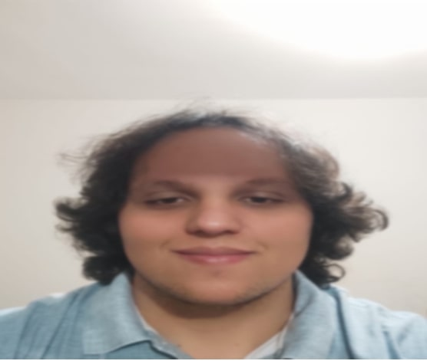
Our Team
Peruzini
Antony
Meus hobbys são assistir nba e tomar café.
Meus hobbys são dormir e receber elogios do Bruno

Slide 6
Our Team
Peruzini
Bruno Blanquez
My hobby is drinking coffe and watch NBA.
My Hobby is …

Slide 7
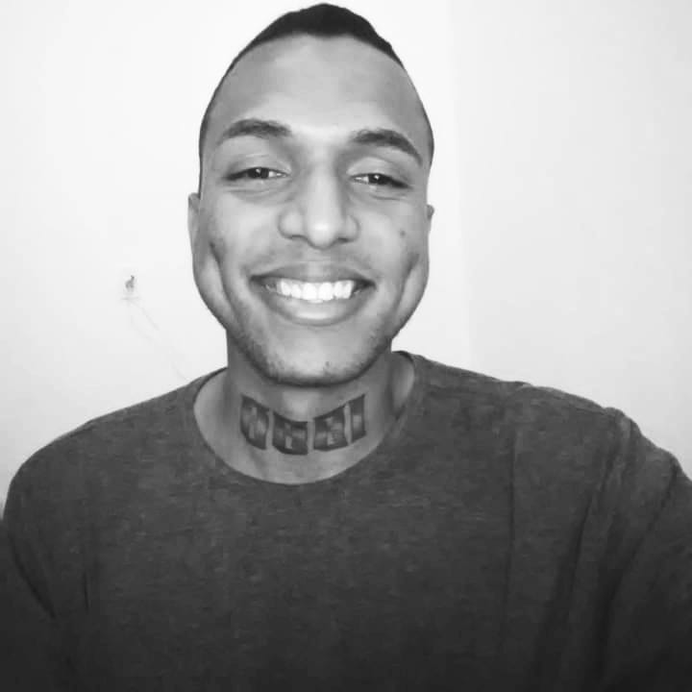
Our Team
Rafael
Meus hobbys são estudar flutter e filosofar .

Slide 8
02
Nossos serviços.
Making your dreams reality.

Slide 9
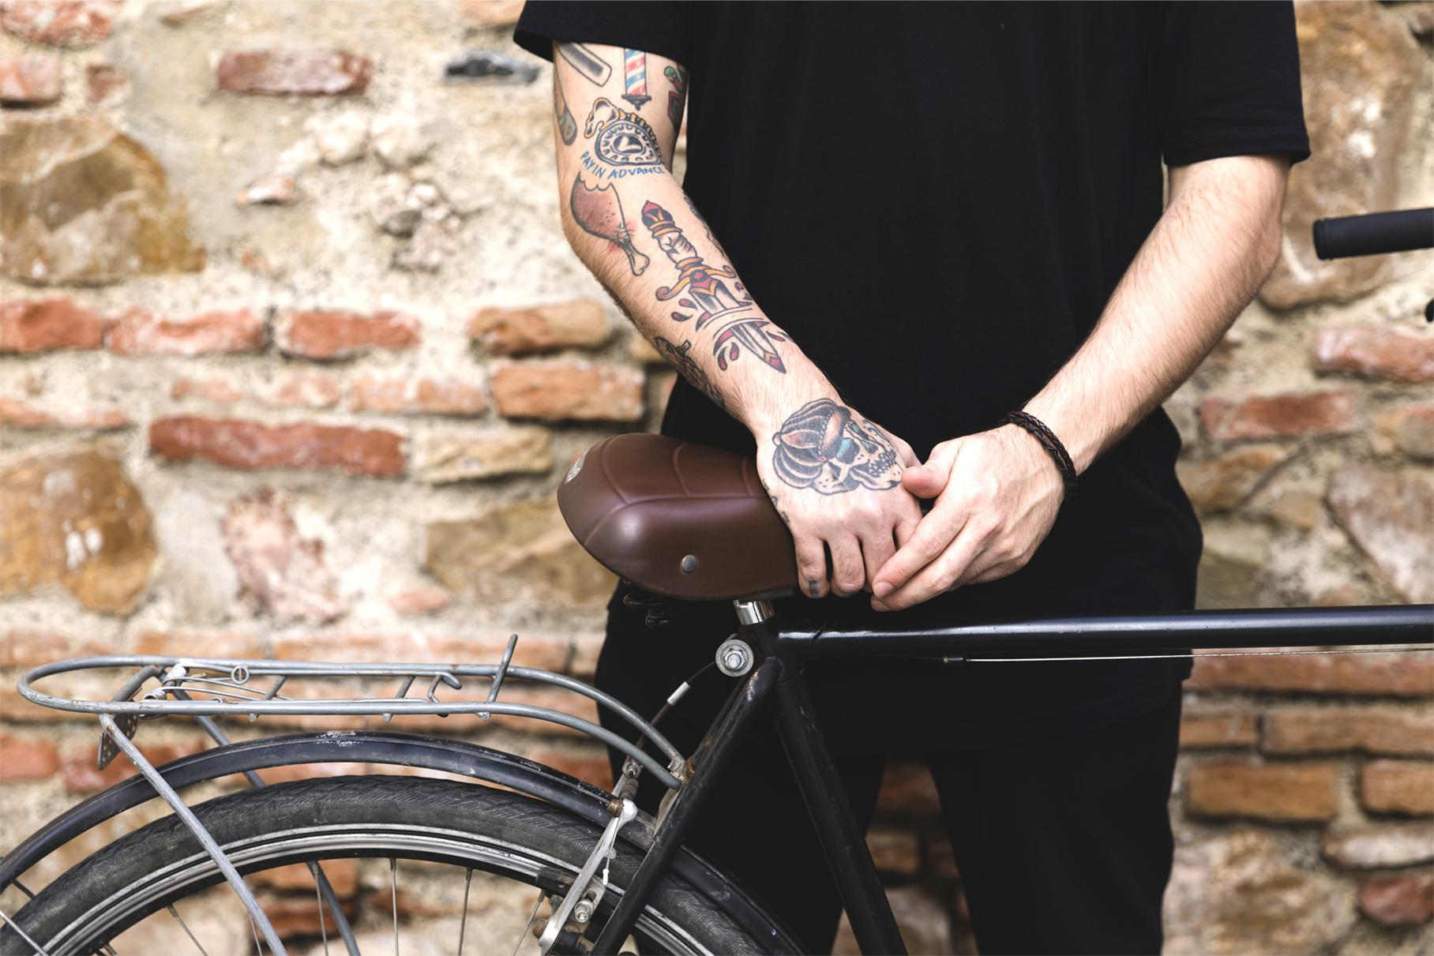
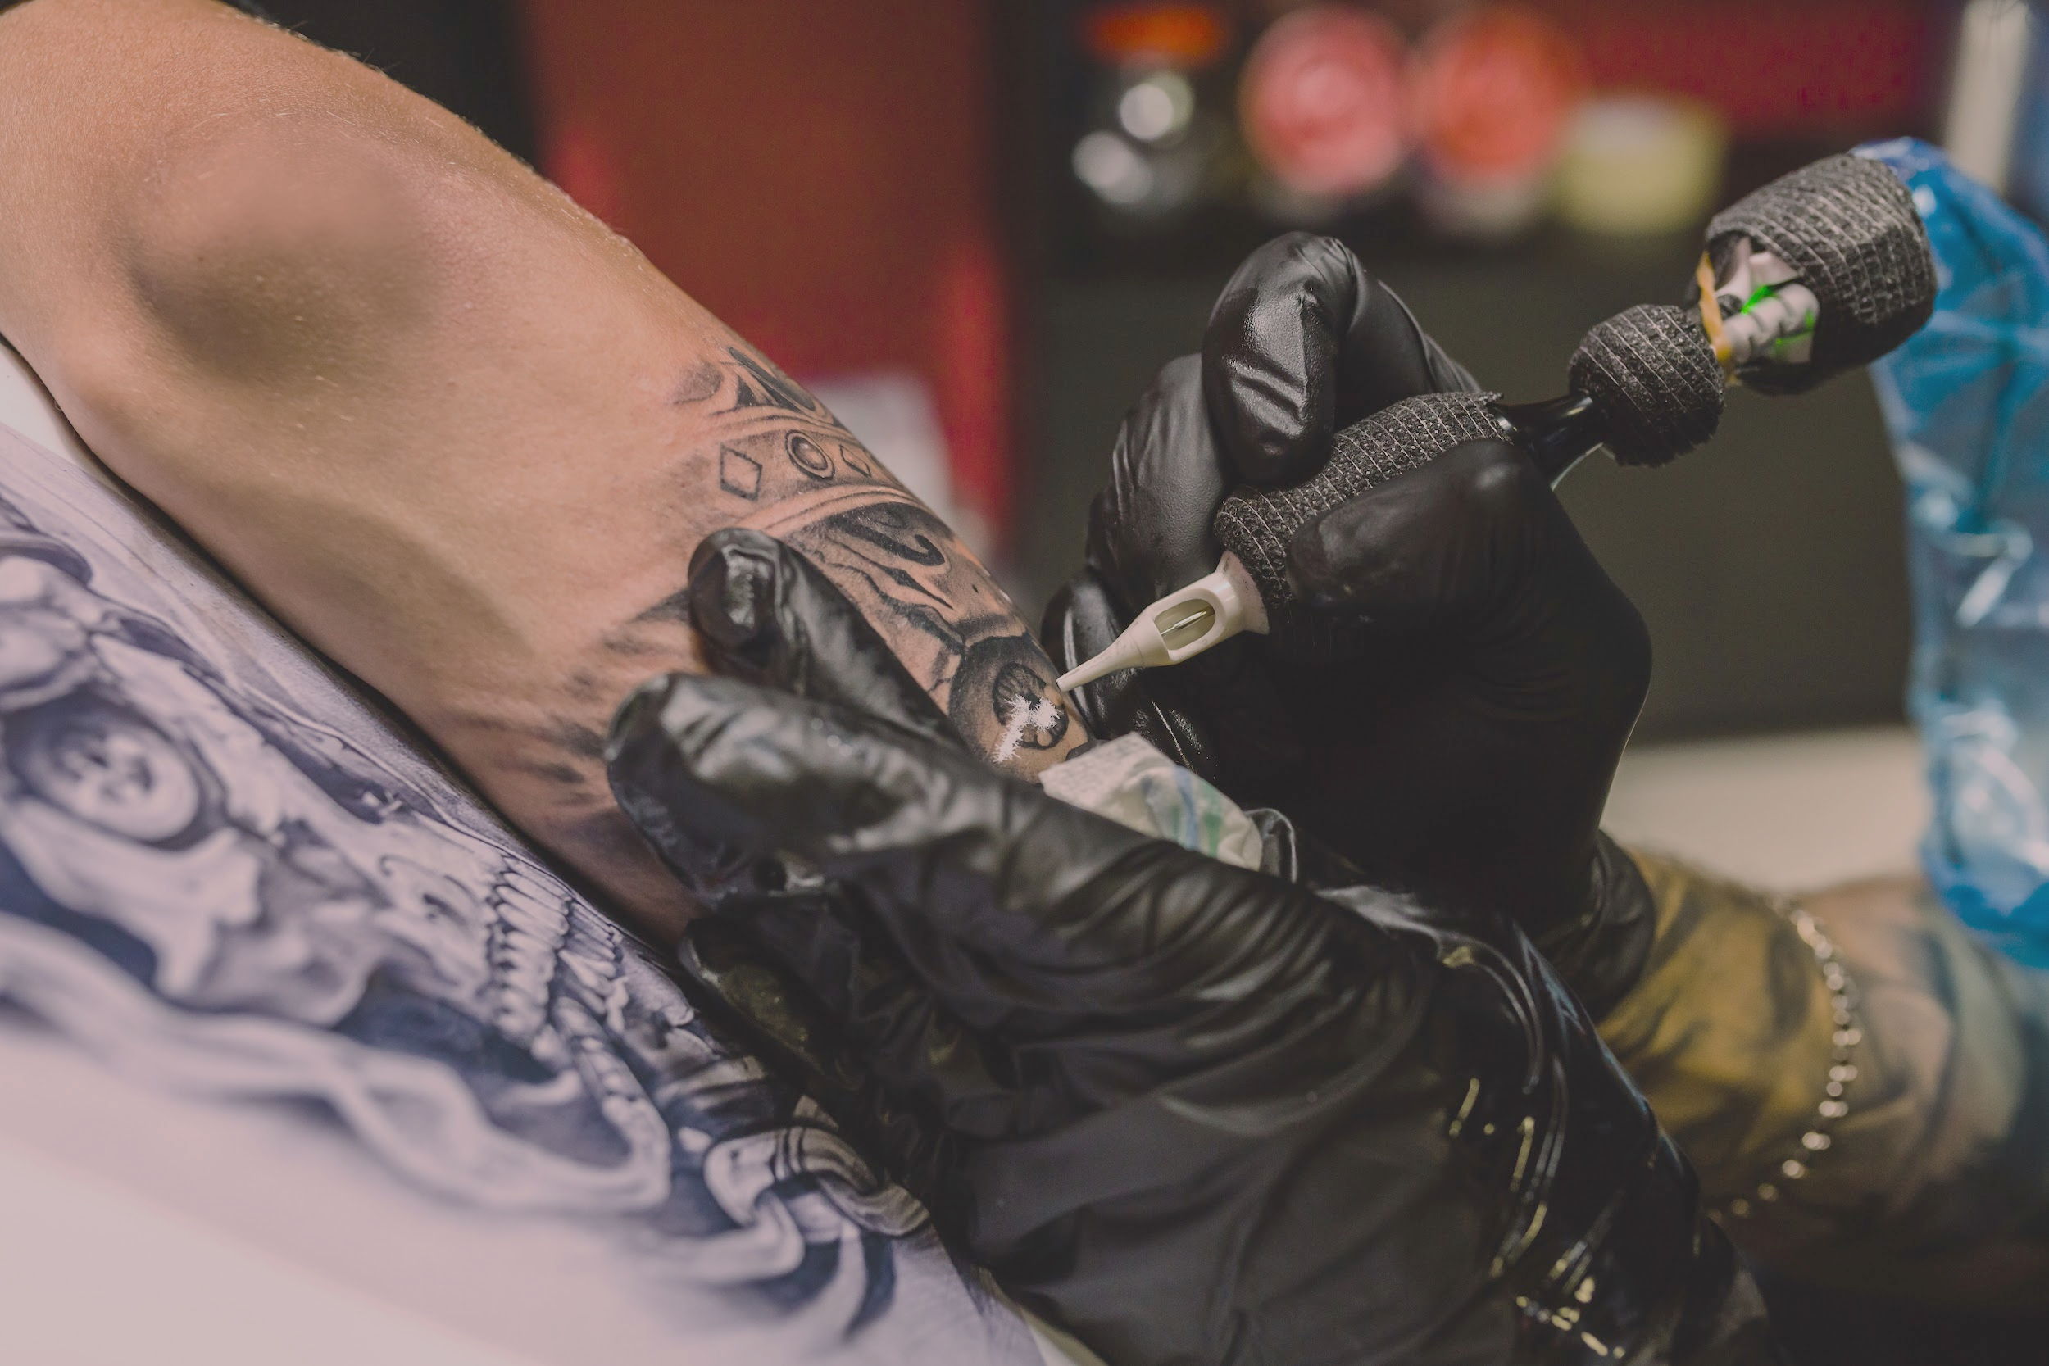
What Do We Offer?
Creativity
Professionalism
"Creativity is seeing what others see and thinking what no one else ever thought.“_{Albert Einstein}
“The skill, good judgment, and polite behavior that is expected from a person who is trained to do a job well” _{Merrium-Webster}

Slide 10
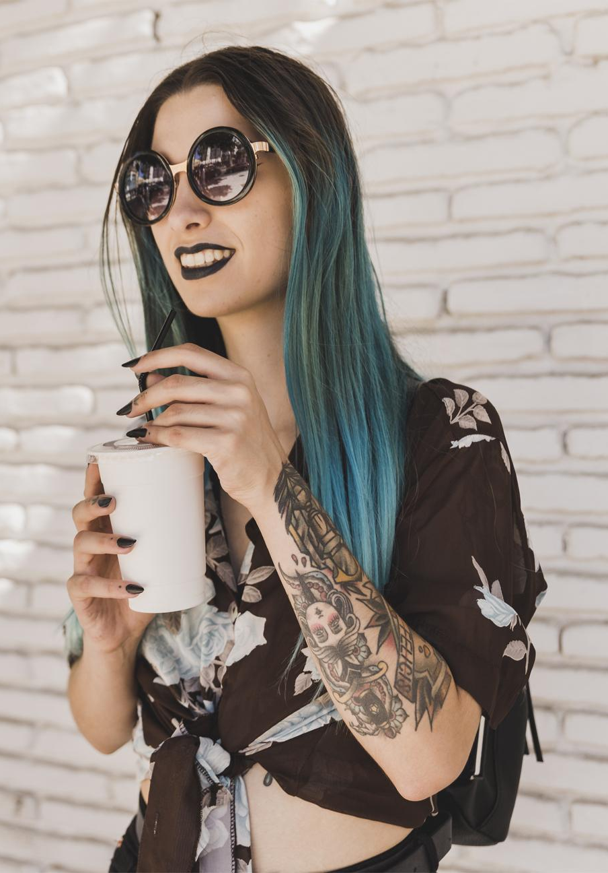
98.8%
of our clients recommend us

Slide 11
03
Como nos faazemos?
Thinking of you.

Slide 12
How Do We Do It?
Plan
Do
Check
Act
Planejar nossas atividades.
Executar nosso planejamento
Checar o funcionamento.
Implementar a solução e rodar o ciclo novamente.

Slide 13
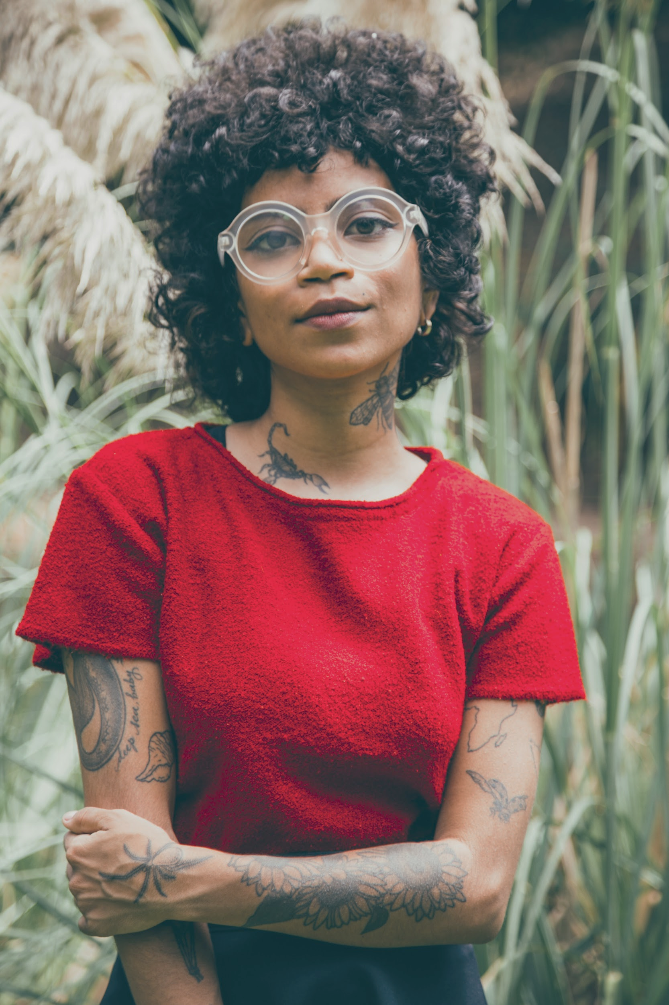
Case Studies
This is our biggest project
We did 1° Reunion
We did our backog division
1° Sprint – we did our Dailys
2° Sprint - we did our Dailys
We help each other
This is the hour of truth.

Slide 14
04
Our Creation
We create a Thousand of Dreams.

Slide 15
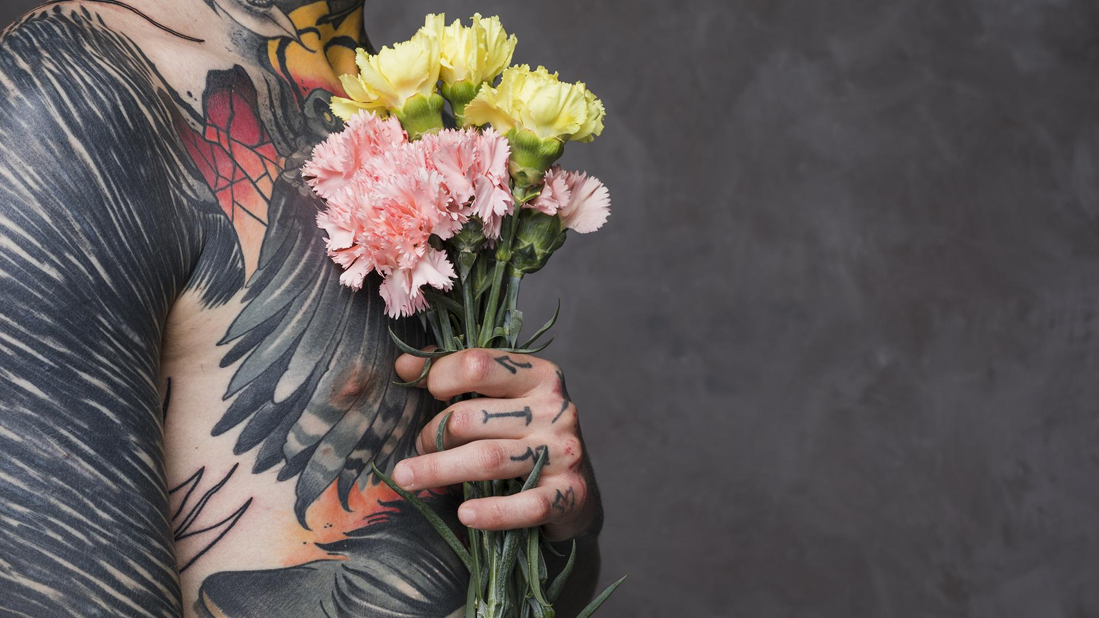
A Picture Is Worth a Thousand Words

Slide 16
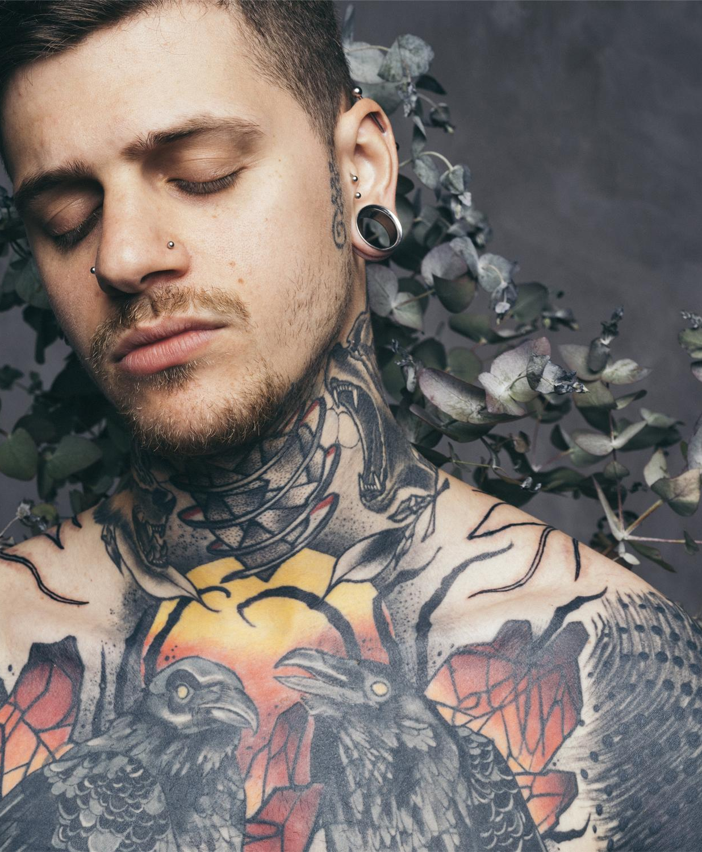
Thanks!
Do you have any questions?

